Slide 1
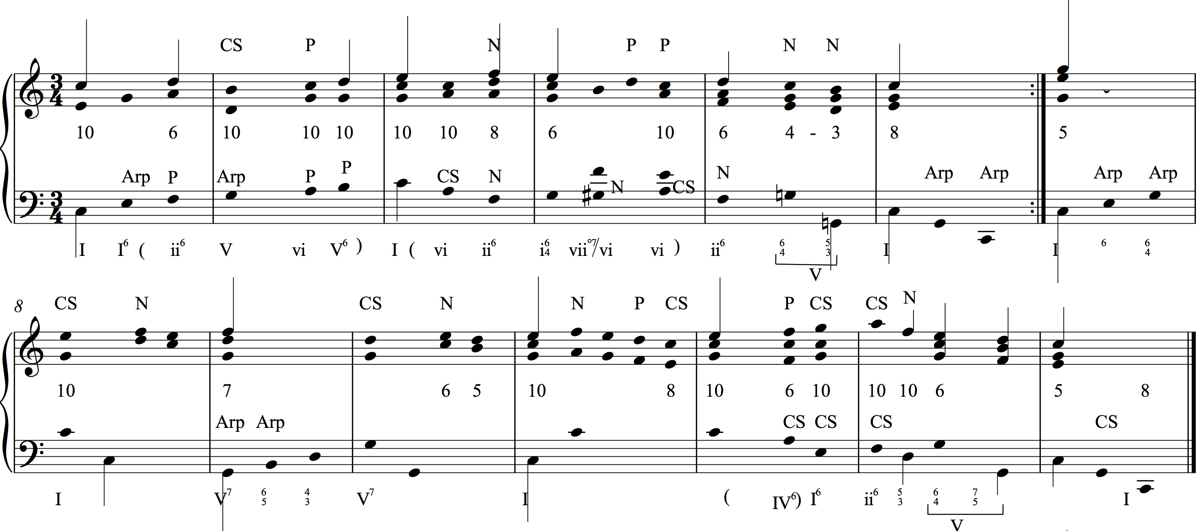
repeated notes in bass and soprano eliminated
stems on structural line in soprano
analysis of stemless noteheads as they relate to stems
stems on structural bass in left hand
numbers between staves show contrapuntal patterns

Slide 2
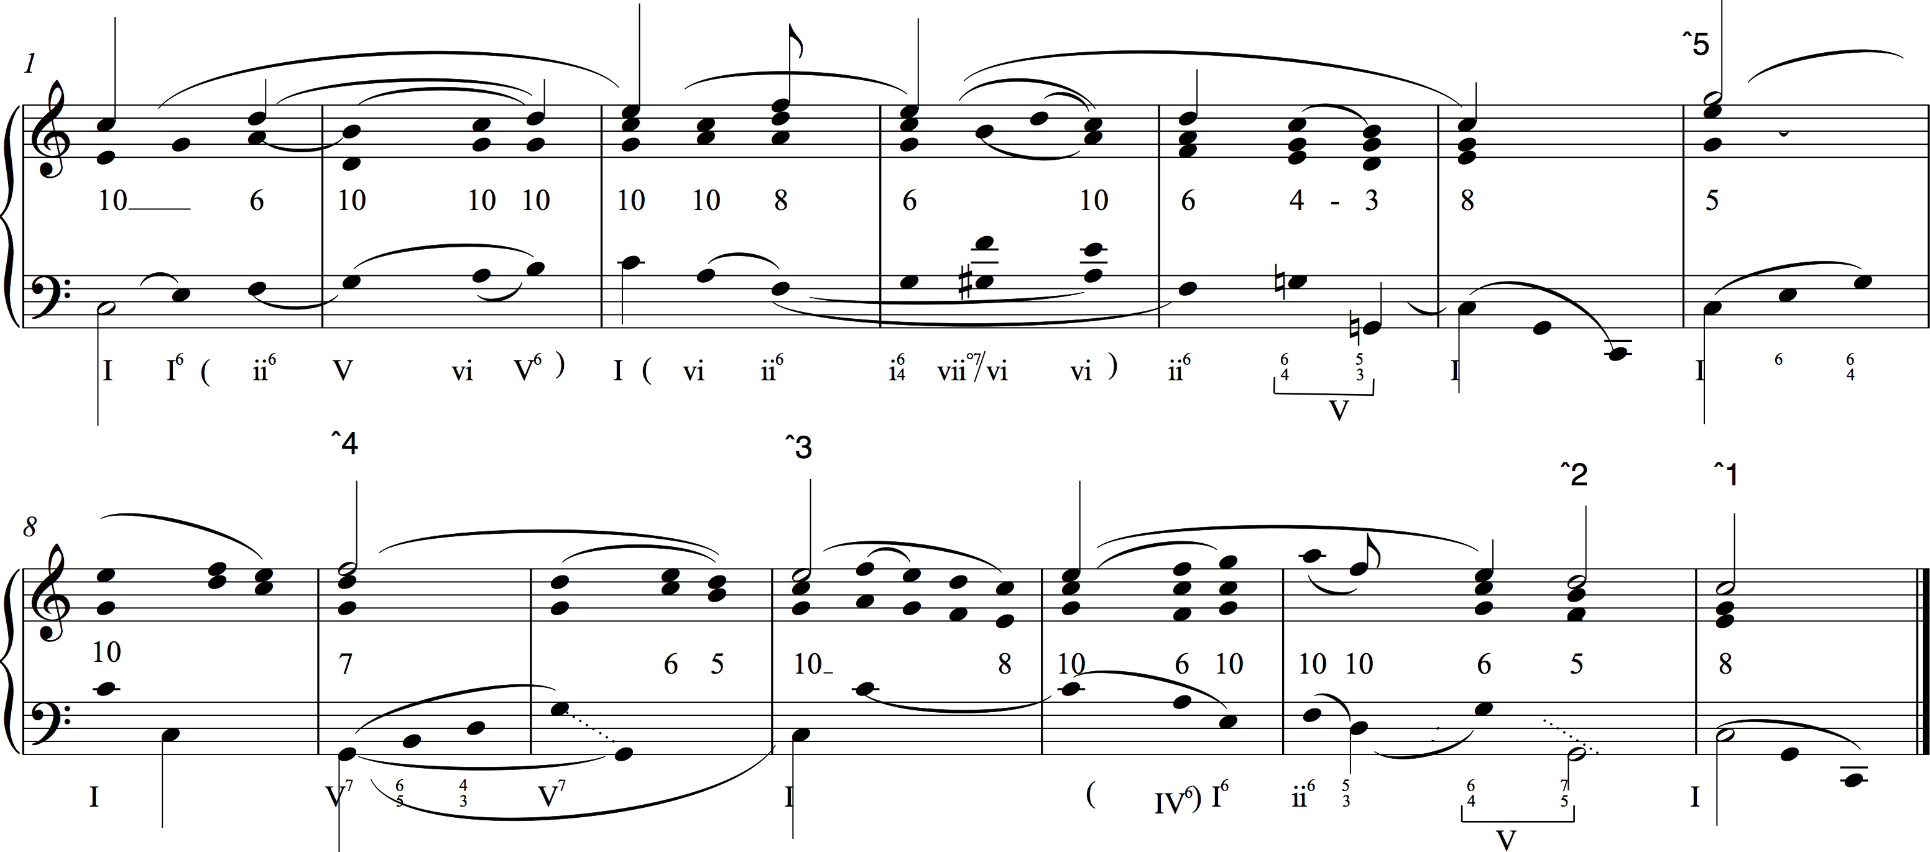
structural descending line (Urlinie) in right hand gets open note heads and scale degrees
slurs replace stemless note labels
structural bass (Bassbrechung) gets open note heads
supported neighbors get flags

Slide 3
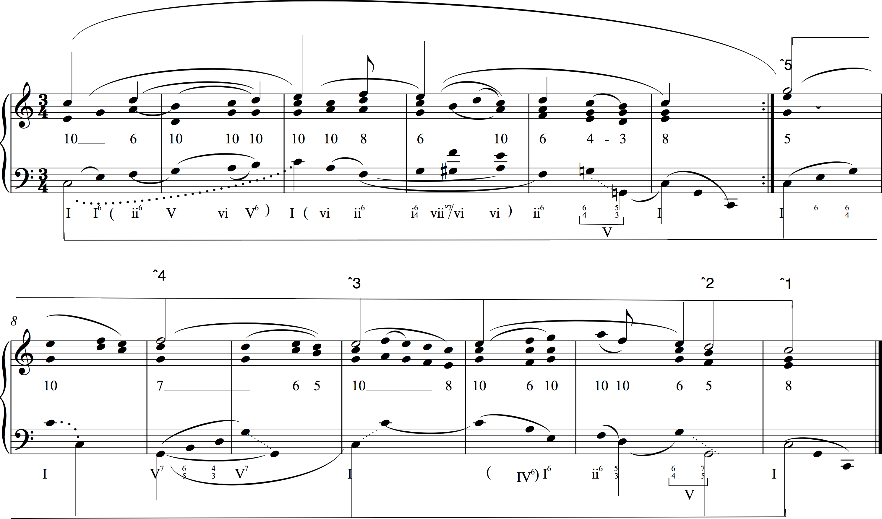
Beams link notes of Urlinie and Bass arpeggiation
structural descending line (Urlinie) in right hand gets open note heads and scale degrees

